Slide 1

message queue
december 2017

Slide 2
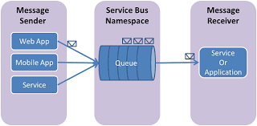
agenda
What is message queue (mq)
MQ structure
Examples of MQ app
Features of Mq
consideration
conclusion
Q & A

Slide 3

What is mq
is a way for applications to send messages
between one another in order
to reliably communicate
is also called asynchronous processing or distributed messaging

Slide 4
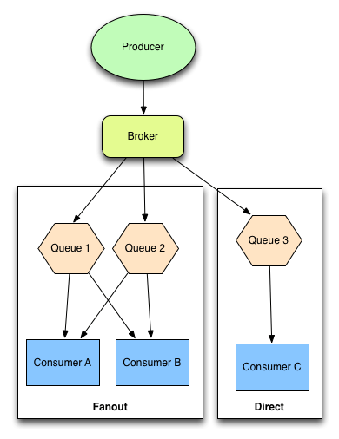
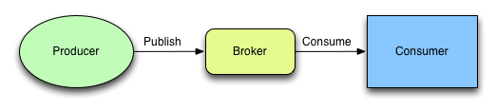
mq structure
a live chat feature, need to send an sms, need to slice up and transcode video, do analysis of our logs, or perhaps just send emails at a high volume

Slide 5
Examples of MQ app
Commercial implementation: IBM WebSphere MQ and Oracle Advanced Queuing (AQ).
Cloud based: Amazon Simple Queue, Service (SQS), StormMQ and IronMQ.
Open Source: Apache ActiveMQ, Apache Kafka, Apache Qpid, Beanstalkd, HTTPSQ, JBoss Messaging, JORAM, RabbitMQ, Sun Open Message Queue, Tarantool, Kestrel, Redis.

Slide 6

Features of Mq
There are no direct connections between programs.
Communication between programs can be independent of time.
Work can be carried out by small, self-contained programs.
Communication can be driven by events.
Applications can assign a priority to a message.
Security.
Data integrity.
Recovery support.

Slide 7

consideration
Message queues are not a panacea and like all tools have their downsides.
Setting up and configuring message queues, especially more complicated ones can add a lot of moving parts to used application.
For more general queues, you often have to define your own state machine for messages.
That is, a message that needs to be passed to three different services for processing requires you to manually architect a queue workflow that supports that.

Slide 8
conclusion
For asynchronous processing of many types, a message queue is often the best tool for the job depending on your needs.

Slide 9

Q & A

Slide 10
references
https://en.wikipedia.org/wiki/Message_queue
https://www.ibm.com/support/knowledgecenter/SSFKSJ_8.0.0/com.ibm.mq.pro.doc
http://blog.codepath.com/2013/01/06/asynchronous-processing-in-web-applications-part-2-developers-need-to-understand-message-queues

Slide 11

Romeo Gandea
tester
+373 692 8 60 40
Romeo.Gandea@endava.com

